Slide 1


Slide 2
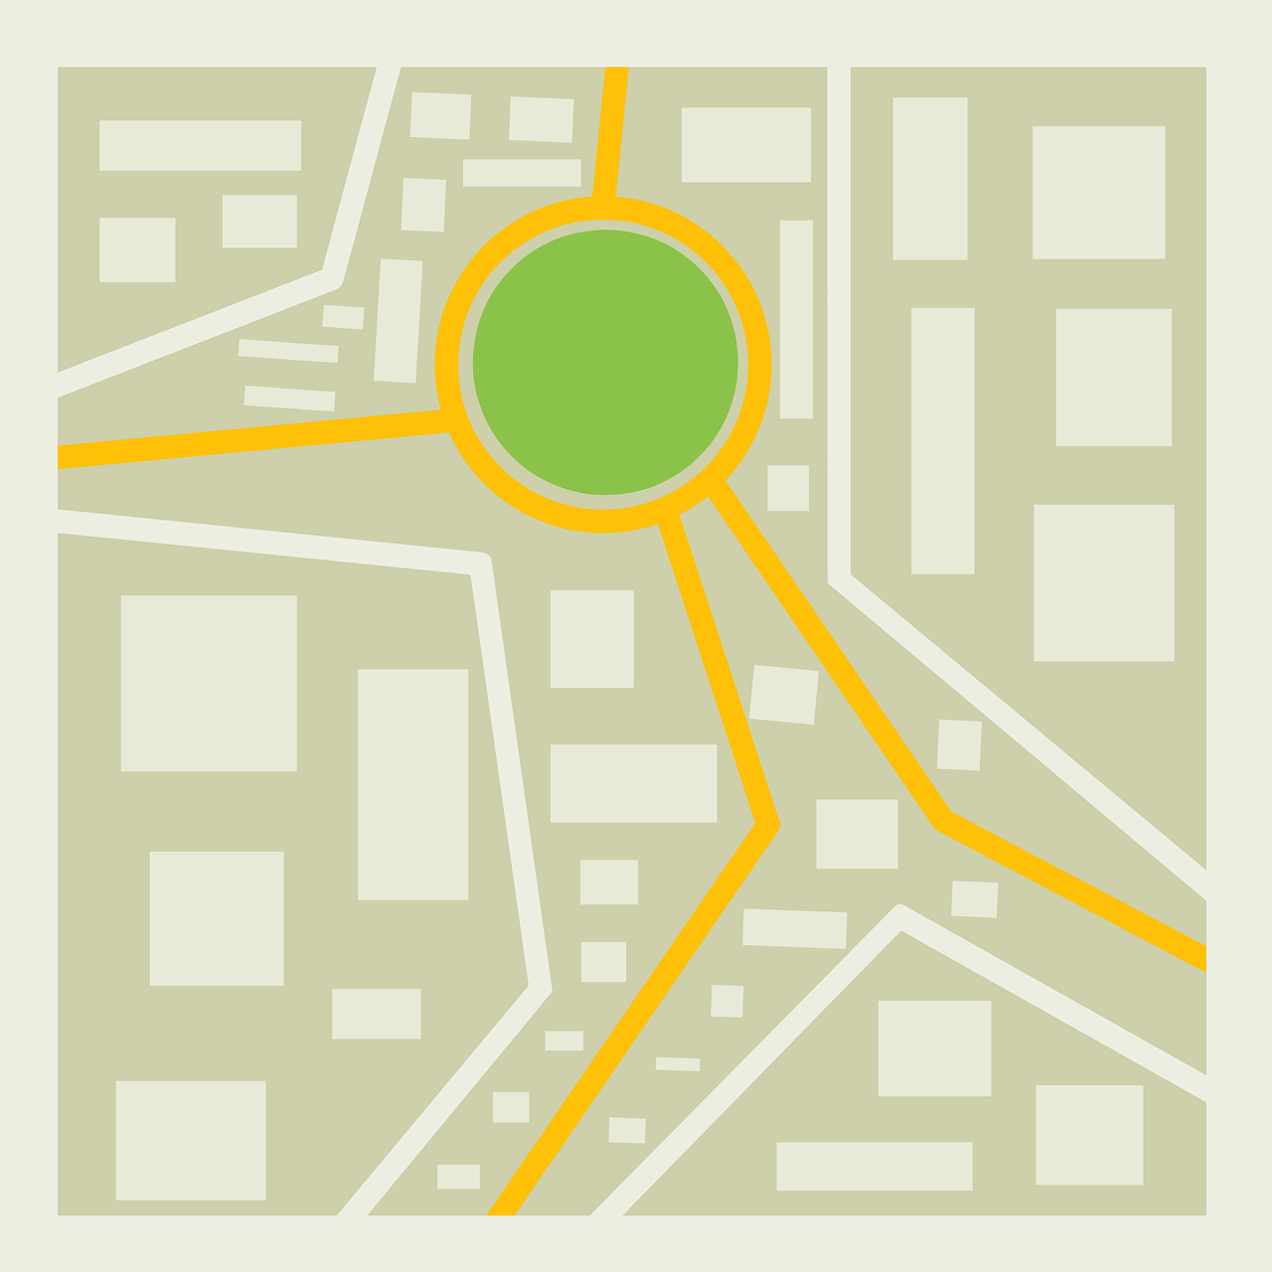


Need for monitoring and assistance?
TOOL FOR MONITORING
GROUND PERSONNEL
Personnel leave their designated areas during duty.
Increases possibility of instability due to lack of personnel.
Indian crowds tend to get chaotic under lack of supervision.
Abrupt chaos requires urgent additional backup.
KVH - 013
Platform/tool to remotely track police officers deployed to Bandobast duty to ensure that they stay where they are posted.

Slide 3
Need for monitoring and assistance?
Required solution features
Personnel leave their designated areas during duty.
Increases possibility of instability due to lack of personnel.
Indian crowds tend to get chaotic under lack of supervision.
Abrupt chaos requires urgent additional backup.
Geofencing capability
Live personnel tracking
Notify supervisors incase of violation
Easy and intuitive
Low cost
Scalable
Less intrusive

Slide 4
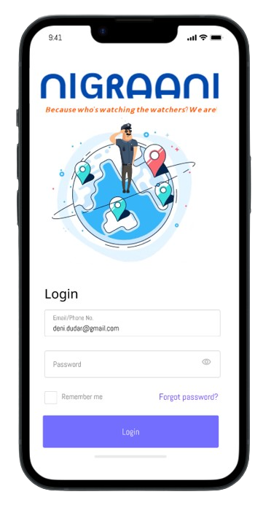
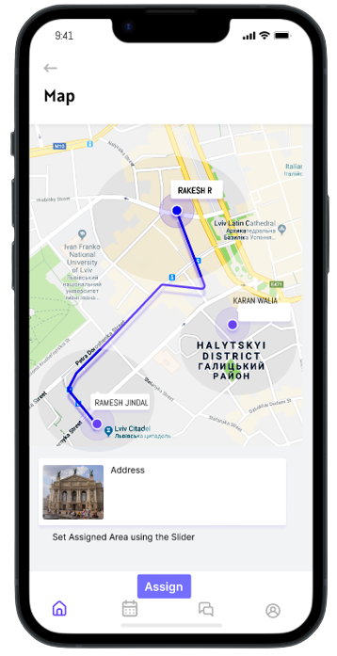
Required solution features
Nigraani
Geofencing capability
Live personnel tracking
Notify supervisors incase of violation
Easy and intuitive
Low cost
Scalable
Less intrusive
Because who's watching the watchers?
We are!
A Geofencing App + hardware based solution to monitor and assist Ground Personnel assigned on Bandobast Duty.

Slide 5
Features of our app
Nigraani
GPS based Geofencing
Live personnel tracking
Alert to supervisors in case of violations
Personnel Recommendation Algorithm
Ability to request urgent backup
Because who's watching the watchers?
We are!
A Geofencing App + hardware based solution to monitor and assist Ground Personnel assigned on Bandobast Duty.

Slide 6

Global Positioning System [GPS]
Features of our app
GPS based Geofencing
Live personnel tracking
Alert to supervisors in case of violations
Personnel Recommendation Algorithm
Ability to request urgent backup
Works in remote areas
Sufficiently Long Range
Precise positioning
Reliable connection
Can be implemented using inhouse technologies [NavIC]
Specially developed for positioning

Slide 7
Global Positioning System [GPS]
Sufficiently Long Range
Works in remote areas
Reliable connection
Precise positioning
Specially developed for positioning
Can be implemented using inhouse technologies [NavIC]

Slide 8

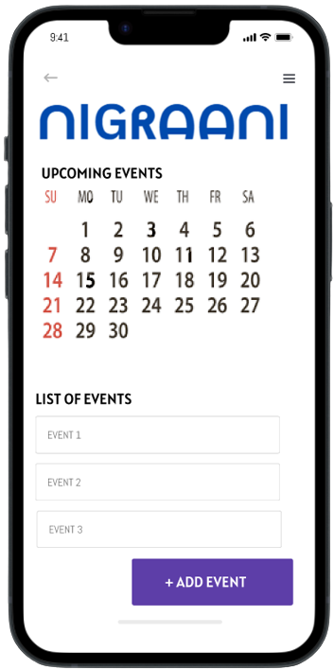
Supervisor Section
Ability to allocate sectors and subsectors to personnel.
Personnel Recommendation Algorithm.
Live personnel tracking
Notification incase of duty violation.

Slide 9
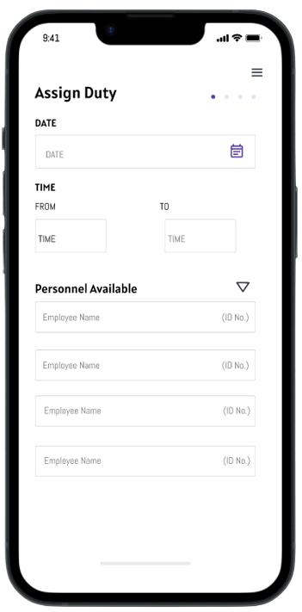
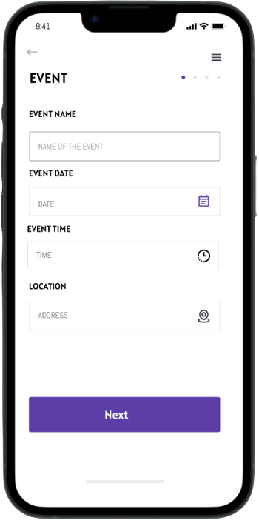
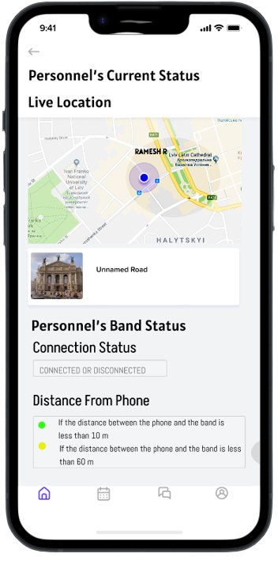
Supervisor Section
Ability to allocate sectors and subsectors to personnel.
Personnel Recommendation Algorithm.
Live personnel tracking
Notification incase of duty violation.

Slide 10
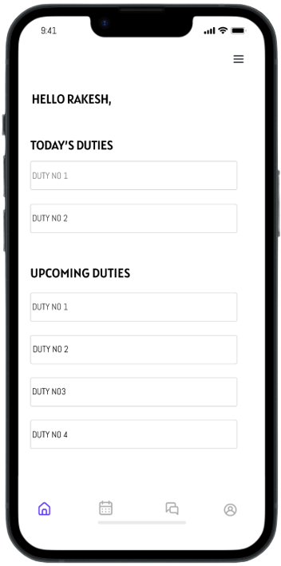
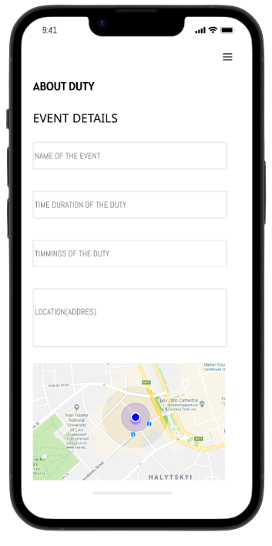
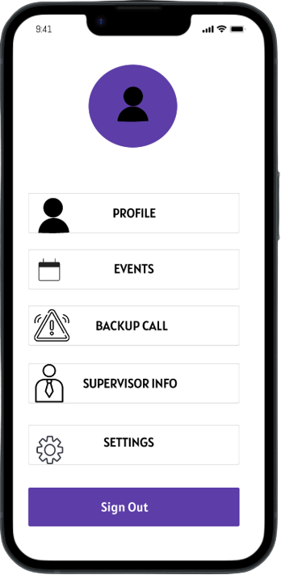
Supervisor Section
Personnel Section

Slide 11


2 loopholes remaining….
Personnel Section
Assigned Event Details
Personnel’s Dashboard
Upcoming Event list
What if the smartphone is left in the area and the personnel leaves?
What if the smartphone runs out of charge?

Slide 12
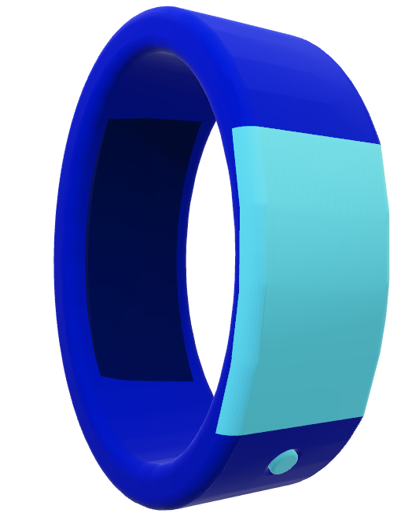
2 loopholes remaining….
What if the smartphone is left in the area and the personnel leaves?
Wearable Band
Wearable solution which works on Bluetooth LE and NFC.
Integrated Solar Cells.
What if the smartphone runs out of charge?

Slide 13
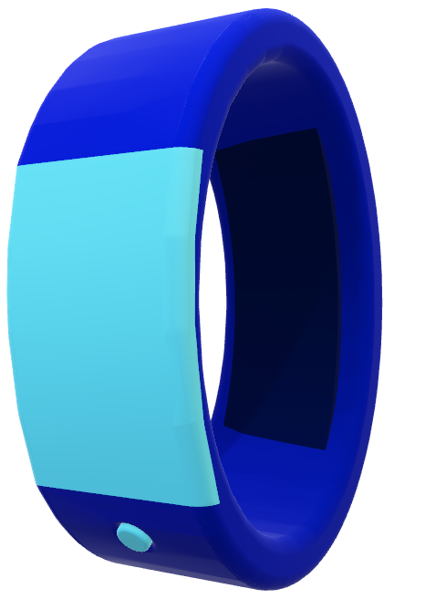
Wearable Band
Wearable solution which works on Bluetooth LE and NFC.
Integrated Solar Cells.

Slide 14
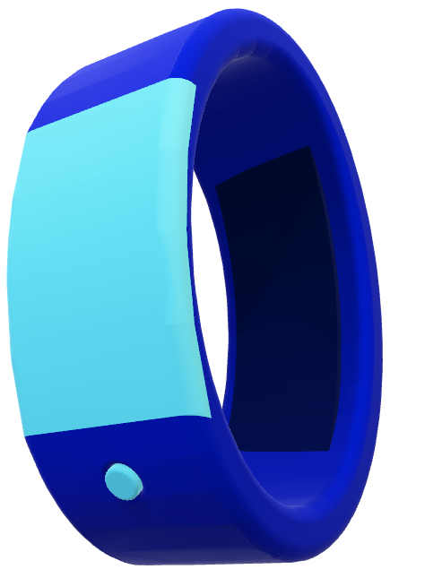
Solar Cells
Keep the band charged at all times.
Due to Bluetooth LE (Low Energy) and NFC being very low powered technologies, the band can stay charged for upto 10 years.
Programmable Button
Physical Input Interface
Urgent backup Alert

Slide 15
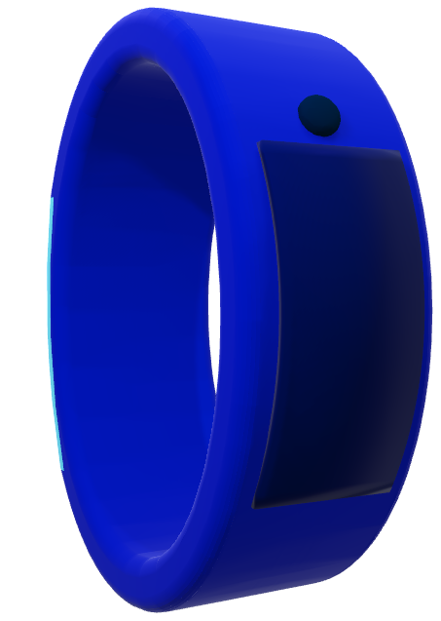
Locking Mechanism
Robust and Secure
Alert is sent if opened during duty
Bluetooth Low Energy
Distance upto 20 meters
Communicates with smartphone
Consumes very low power
Near Field Communication [NFC]
Distance upto 10 cm.
Used to program band before duty.

Slide 16

Cybersecurity Features
If smartphone runs out of charge
Data-in-Transit
TLS 1.2
HTTPS
AES - 256
Data on Cloud
Homomorphic Encryption
Bluetooth
Passkey Entry
Band connects with devices of nearby personnel

Slide 17
Cybersecurity Features
Future RoadMap
Data-in-Transit
TLS 1.2
HTTPS
AES - 256
Two Factor Authentication
Cell Tower Triangulation
Data on Cloud
Homomorphic Encryption
Bluetooth
Passkey Entry

Slide 18
Future RoadMap
Two Factor Authentication
Cell Tower Triangulation

Slide 19
Thank You !

